Slide 1

Value Added Course Exergy Analysis of Alternative Fuels based Advanced IC Engines
Dr. M. Feroskhan & Dr. M. Sreekanth

Slide 2
Concepts of Thermodynamics

Slide 3
Concepts of Thermodynamics

Slide 4
Entropy Change of an Incompressible Substance

Slide 5
Entropy Change of an Ideal Gas

Slide 6
Entropy Balance

Slide 7
Entropy Balance for Closed System

Slide 8
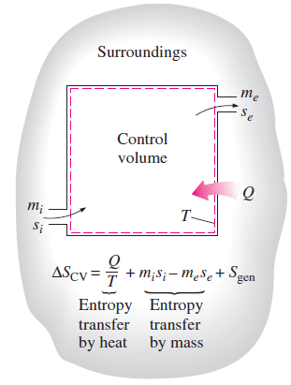
Entropy Balance for Open System

Slide 9
Availability (Exergy)
The useful work potential of a given amount of energy at some specified state is called Exergy or Availability or Available Energy
The Work Potential of the energy contained in a system at a specified state is simply the maximum useful work that can be obtained from the system
A system delivers the maximum possible work as it undergoes a reversible process from the specified initial state to the state of its environment, that is the Dead State

Slide 10
Exergy of an Open System

Slide 11
Exergy Transfer

Slide 12
Decrease of Exergy Principle
Exergy of an isolated system during a process always decreases
Only in a reversible process, exergy remains constant
Exergy never increases and in an actual process it is destroyed and is given by the Gouy-Stodola Theorem

Slide 13
Exergy Destruction

Slide 14
Exergy Balance

Slide 15
Summary

Slide 16
Problem-1 (SFEE)
Steam enters an adiabatic turbine at 10 MPa and 500 ℃ and leaves at 10 kPa with a quality of 90%. Neglecting the changes in KE and PE, determine the mass flow rate required for a power output of 5 MW.
Ans: 4.852 kg/s

Slide 19
Problem-2 (SFEE)
Steam enters a steady-flow turbine with a mass flow rate of 13 kg/s at 600℃, 8 MPa, and a negligible velocity. The steam expands in the turbine to a saturated vapour at 300 kPa where 10% of the steam is removed for some other use. The reminder of the steam continues to expand to the turbine exit where the pressure is 10 kPa and quality is 85%. If the turbine is adiabatic, determine the rate of work done by the steam during the process.
Ans: 17.8 MW

Slide 22
Problem-3 (SFEE)
Refrigerant 134a at 1 MPa and 90℃ is to be cooled to 1 MPa and 30℃ in a condenser by air. The air enters at 100 kPa and 27℃ with a volume flow rate of 600 m³/min and leaves at 95 kPa and 60℃. Determine the mass flow rate of the refrigerant.
Ans: 100 kg/min = 1.66 kg/s

Slide 25
Problem-4 (Entropy)
Air is compressed steadily by a 5 kW compressor from 100 kPa and 17℃ to 600 kPa and 167℃ at a rate of 1.6 kg/min. During this process, some heat transfer takes place between the compressor and the surrounding medium at 17℃. Determine the rate of entropy change of air during this process.
Ans: -0.0025 kW/K

Slide 27
Problem-5 (Entropy)
The radiator of a steam heating system has a volume of 20 litres and is filled with superheated water vapour at 200 kPa and 150℃. At this moment both the inlet and exit valves to the radiator are closed. After a while, the temperature of the steam drops to 40℃ as a result of heat transfer to the room air. Determine the entropy change of the steam during this process.
Ans: -0.132 kJ/K

Slide 29
Problem-6 (Entropy)
In an ice-making plant, water at 0℃ is frozen at atmospheric pressure by evaporating saturated R-134a liquid at -16℃. The refrigerant leaves this evaporator as a saturated vapour, and the plant is sized to produce ice at 0℃ at a rate of 2500 kg/h. Determine the rate of entropy generation in this plant.
Ans: 0.0528 kW/K

Slide 32
Problem-7 (Exergy)
Steam is throttled from 7 MPa and 500℃ to a pressure of 1 MPa. Determine the decrease in exergy of the steam during the process. Assume the surroundings to be at 25℃.
Ans: 261 kJ/kg

Slide 34
Problem-8 (Exergy)
Refrigerant-134a enters an adiabatic compressor at -30℃ as a saturated vapour at a rate of 0.45 m³/min and leaves at 900 kPa and 55℃. Determine (a) the power input to the compressor, (b) the isentropic efficiency, and (c) the rate of exergy destruction and the 2nd law efficiency of the compressor. Take T₀=27℃
Ans: (a) 1.92 kW, (b) 85.3%, (c) 0.261 kW, 86.4%

Slide 38
Problem-9 (Exergy)
A hot-water stream at 70℃ enters an adiabatic mixing chamber with a mass flow rate of 2 kg/s, where it is mixed with a stream of cold water at 20℃. If the mixture leaves the chamber at 45℃, determine (a) the mass flow rate of the cold water and (b) the exergy destroyed during this adiabatic mixing process. Assume all the streams are at a pressure of 350 kPa and the surroundings are at 25℃.
Ans: (a) 2 kg/s, (b) 15.5 kW

Slide 42
Problem-10 (Exergy)
Steam enters a two-stage adiabatic turbine at 8 MPa and 500℃. It expands in the first stage to a state of 2 MPa and 350℃. Steam is then reheated at constant pressure to a temperature of 500℃ before it is routed to the second stage, where it exits at 30 kPa and a quality of 97%. The work output of the turbine is 5 MW. Assuming the surroundings to be at 25℃, determine the reversible power output and the rate of exergy destruction within this turbine.
Ans: 5457 kW, 457 kW

Slide 46
Chemical Exergy

Slide 47
Total Exergy
Total exergy is a sum of thermo-mechanical exergy and chemical exergy

Slide 48
Chemical Exergy
Chemical Exergy is the exergy available in chemical form
This exergy can be extracted through a chemical reaction
Chemical exergy of
An element
A compound
A gas mixture

Slide 49
Evaluating Chemical Exergy

Slide 50
Evaluating Chemical Exergy (using standard exergy values)
The values of standard exergies can be obtained from tables. Use either Model I or Model II.

Slide 51
Evaluating Chemical Exergy…

Slide 52
Evaluating Chemical Exergy of Fuels

Slide 53
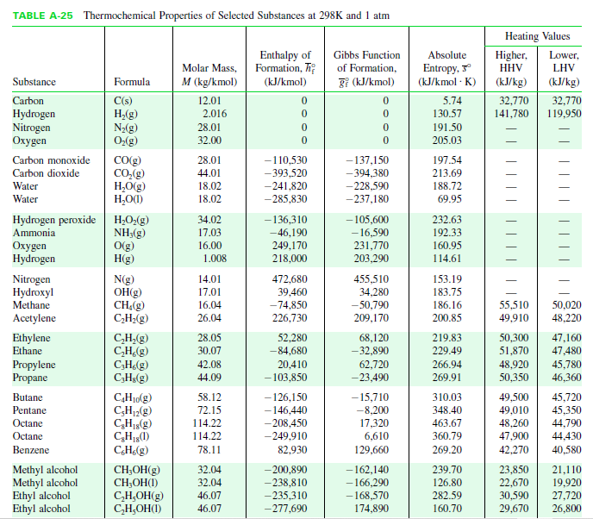
Gibbs Function

Slide 54
Standard Molar Chemical Exergy Values

Slide 55
Numerical Problems

Slide 56
Problem 1
Determine the chemical exergy of liquid octane at 25 ℃, 1 atm, in kJ/kg for an environment consisting of a gas phase at 25℃, 1 atm obeying the ideal gas model with the following composition on a molar basis: N₂, 75.67%; O₂, 20.35%; H₂O, 3.12%; CO₂, 0.03%; other, 0.83%.
(Moran eg 13.12)

Slide 58
Problem 2
Steam at 5 bar, 240℃ leaks from a line in a vapor power plant. Evaluate the flow exergy of the steam, in kJ/kg, relative to an environment at 25C, 1 atm in which the mole fraction of water vapor is 0.0303.
(Moran eg. 13.13)

Slide 60
Problem 3
Methane gas enters a reactor and burns completely with 140% theoretical air. Combustion products exit as a mixture at temperature T and a pressure of 1 atm. For T = 480 and 1560 K, evaluate the flow exergy of the combustion products, in kJ per kmol of fuel. Perform calculations relative to an environment consisting of an ideal gas mixture at 25℃, 1 atm with the molar analysis, N₂=0.7567, O₂=0.2035, H₂O=0.0303, CO₂=0.0003.
(Moran eg 13.14)

Slide 62
Problem 4
A mixture having an analysis on a molar basis of 85% dry air, 15% CO enters a device at 125℃, 2.1 atm, and a velocity of 250 m/s. If the mass flow rate is 1.0 kg/s, determine the rate exergy enters, in kW.
(Moran ex 13.70)

Slide 64
Problem 5
Coal enters the combustor of a power plant with a mass analysis of 49.8% C, 3.5% H, 6.8% O, 6.4% S, 14.1% H₂O, and 19.4% noncombustible ash. The higher heating value of the coal is measured as 21,220 kJ/kg, and the lower heating value on a dry basis, (LHV)d, is 20,450 kJ/kg. Estimate the chemical exergy of this coal.
(Moran ex 13.78)

Slide 65
Problem 6
Determine the chemical exergy of (a) carbon, (b) hydrogen, (c) methane, (d) carbon monoxide, (e) liquid methanol, (f) nitrogen, (g) oxygen, (h) carbon dioxide, and (i) water, in kJ/kg. The environment consists of 75.67% N₂, 20.35% O₂, 3.12% H₂O, 0.03% CO₂ and others 0.83% at 25℃ and 1 atm.
(Nag eg 16.12)

Slide 67
Problem 7
A gasoline engine delivers 150 kW. The fuel used is C₈H₁₈ (l) and it enters the engine at 25℃. 150% theoretical air is used and it enters at 45℃. The products of combustion leave the engine at 750 K, and the heat transfer from the engine is 205 kW. Determine the fuel consumption per hour, if complete combustion is achieved.
(Nag eg 16.9)

Slide 68
Problem 8
Liquid Octane (C₈H₁₈) at 25℃, 1 atm and a mass flow rate of 0.57 kg/h enters a small internal combustion engine operating at steady state. The fuel burns with air entering the engine in a separate stream at 25℃, 1 atm. Combustion products exit at 670 K, 1 atm with a dry molar analysis of 11.4% CO₂, 2.9% CO, 1.6% O₂ and 84.1% N₂. If the engine develops power at the rate of 1 kW, determine (a) the rate of heat transfer from the engine in kW and (b) the 2nd law efficiency of the engine.
(Nag eg 16.13, Moran ex. 13.75)

Slide 69
Problem 9
Liquid octane enters an internal combustion engine operating at steady state with a mass flow rate of 1.8×10⁻³ kg/s and is mixed with the theoretical amount of air. The fuel and air enter the engine at 25℃ and 1 atm. The mixture burns completely and combustion products leave the engine at 890 K. The engine develops a power output of 37 kW. Determine the rate of heat transfer from the engine, in kW, neglecting kinetic and potential energy effects. Also evaluate the exergy efficiency of the engine.
(Moran eg 13.4 & eg 13.15)

Slide 70
Problem 10
A CI engine operates with diesel and biodiesel blends containing nano-particles. In a certain experiment, the engine is operated at 2000 rpm, a torque of 2.5 N-m. The following calculations have been made in kW.
Air exergy = 1.8273×10-4 kW; Fuel exergy = 4.4137 kW; Exhaust gas exergy = 0.1968 kW; Exergy lost due to heat transfer = 0.4201 kW.
Compute the exergy destroyed and the 2nd law efficiency.
If the exergy of air is neglected, what would be the amount of error?
Ans: Exergy destroyed = 3.2737 kW, 2nd law efficiency = 11.86%, Error = 0.006%

Slide 71
Exergo-Economics

Slide 72
Exergo-Economics Equations

Slide 73
Exergo-Economics Equations…

Slide 74
Model calculation

Slide 75
Model Calculation…

